Slide 1

BUT HOW DOES THE MACHINE LEARN?
Ernesto Mori
Vandana Ramakrishnan
Nathan Matare
Patrick Miller
Jordan Bell-Masterson

Slide 2




Motivation
Explosion of interest since mid-2000s
High quality/quantity data
Influx of research and analytics
Great area for applied ML
Notes:
Negative Cash Flows
Content spending spree
International
Costs needed to sustain expansion
NFLX’s headway on its “cream skimming” strategy runs out
Needs to move to acquisition or production of local language content, which is critical to its success abroad.

Slide 3
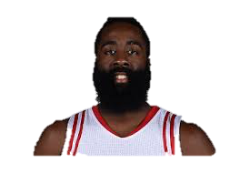
So how much is James Harden going to score tonight?
James Harden
Points Predicted
??
Factors influencing
??

Slide 4
Data Description
Aggregated player and team statistics, matchup information, court atmospherics, analyst reports, and player information
4259 total features; 97,866 observations over 2013 – 2016 NBA seasons; 650+ league players
Each observation(row) is nth player game time appearance
Feature Type | Time Period | Type | Example
Player statistics | t-1 to t-10 | Continuous | Points, rebounds, fouls, assists
Players team statistics | t-1 to t-10 | Continuous | Team points, team rebounds
Opposing teams statistics | t-1 to t-10 | Continuous | Team points, team rebounds
Player biography information | t-0 | Mixed | Height, weight, position, experience
Player injury statistics | t-0 to t-10 | Categorical | Head, Achilles, Quad, Illness
Game atmospherics | t-0 | Mixed | Game time, venue, broadcast network
Analyst/Text reports | Between games | Bag of Words/n-gram | “great game”, “hot-streak”, topic 1:10
Matchup information | t-0 | Binary | 1 players team, 0 not on court, -1 opposing team
Notes:
Negative Cash Flows
Content spending spree
International
Costs needed to sustain expansion
NFLX’s headway on its “cream skimming” strategy runs out
Needs to move to acquisition or production of local language content, which is critical to its success abroad.

Slide 5
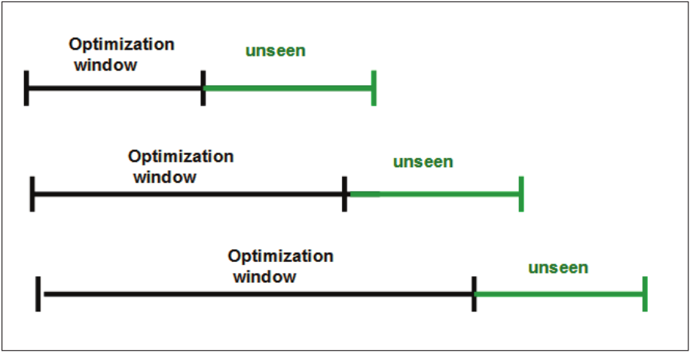
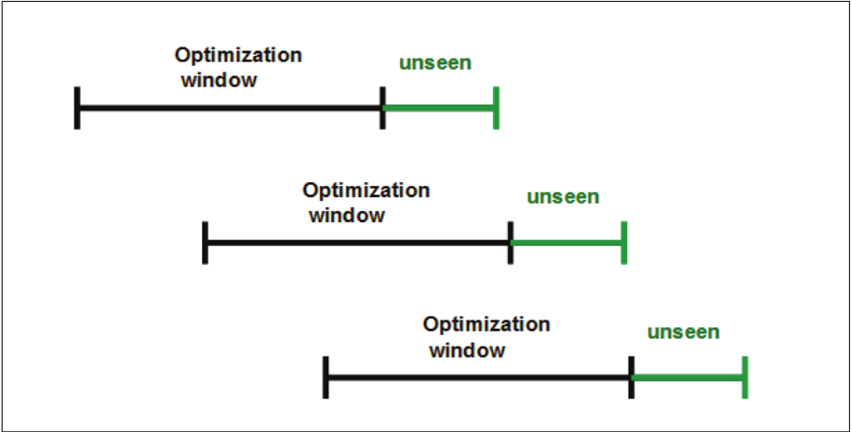
Time Series Cross Validation
Time series dependency among lagged variables t-0 through t-10
Anchored Window
Rolling Window
Notes:
Negative Cash Flows
Content spending spree
International
Costs needed to sustain expansion
NFLX’s headway on its “cream skimming” strategy runs out
Needs to move to acquisition or production of local language content, which is critical to its success abroad.

Slide 6
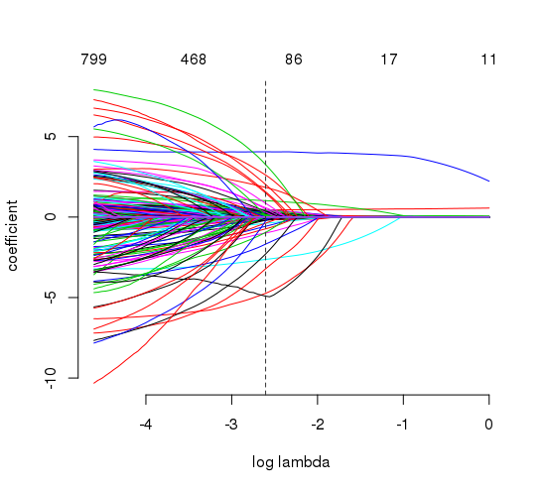
Model 1 – Linear Model (gamlr)
We start with a LASSO constructing a linear model
We select the following parameters: free = NULL, lamba.min.ratio = 1e-9, lambda.start = 1.00, gamma = 0
We do 6 out of sample predictions (graph to the left is first run)
Mean of RMSEs of all runs is 4.277664
Computationally, not super fast.
User | System | Elapsed
29.098 | 0.189 | 29.239
Notes:
Negative Cash Flows
Content spending spree
International
Costs needed to sustain expansion
NFLX’s headway on its “cream skimming” strategy runs out
Needs to move to acquisition or production of local language content, which is critical to its success abroad.

Slide 7
Model 2 – Random Forest (ranger)
We continue with a random forest
We select the following parameters: ntree = 100, nodesize = 5
We do 6 out of sample predictions (output to the left is first run)
Mean of RMSEs of all runs is 4.539297
Computationally, much faster:
Call: ranger(y.transformed ~ ., data = cbind.data.frame(y.transformed, as.matrix(x)), probability = FALSE, classification = FALSE, num.trees = ntree, write.forest = TRUE, num.threads = cores, importance = "impurity", verbose = FALSE, ... = ...)
Type: Regression Number of trees: 100 Sample size: 9890 Number of independent variables: 1011 Mtry: 31 Target node size: 5 Variable importance mode: impurity OOB prediction error: 27.64754 R squared: 0.553616
User | System | Elapsed
96.002 | 0.247 | 22.254
Notes:
Negative Cash Flows
Content spending spree
International
Costs needed to sustain expansion
NFLX’s headway on its “cream skimming” strategy runs out
Needs to move to acquisition or production of local language content, which is critical to its success abroad.

Slide 8
Model 3 – Boosting (xgboost)
We next try boosting
We select the following parameters: rounds = 10, max.dept = 2
We do 6 out of sample predictions (output to the left is first run)
Mean of RMSEs of all runs is 4.56958
Computationally, even faster:
##### xgb.Booster
raw: 604.8 Kb
call:
xgb.train(params = params, data = dtrain, nrounds = nrounds,
watchlist = watchlist, verbose = verbose, print_every_n = print_every_n,
early_stopping_rounds = early_stopping_rounds, maximize = maximize,
save_period = save_period, save_name = save_name, xgb_model = xgb_model,
callbacks = callbacks, max_depth = ..1, nthread = ..2, objective = "reg:linear")
params (as set within xgb.train):
max_depth = "100", nthread = "7", objective = "reg:linear", silent = "1"
xgb.attributes:
niter
callbacks:
cb.save.model(save_period = save_period, save_name = save_name)
niter: 5
User | System | Elapsed
102.941 | 0.271 | 17.845
Notes:
Negative Cash Flows
Content spending spree
International
Costs needed to sustain expansion
NFLX’s headway on its “cream skimming” strategy runs out
Needs to move to acquisition or production of local language content, which is critical to its success abroad.

Slide 9
Model 4 – Forward Neural Net (h20)
H2ORegressionModel: deeplearning
Model ID: DeepLearning_model_R_1489083894745_17
Status of Neuron Layers: predicting points.y_var, regression, gaussian distribution, Quadratic loss, 240,401 weights/biases, 2.9 MB, 54,291 training samples, mini-batch size 1
layer units type dropout l1 l2 mean_rate rate_rms momentum
1 1 999 Input 20.00 %
2 2 200 Tanh 0.00 % 0.000000 0.000000 0.080045 0.197153 0.000000
3 3 200 Tanh 0.00 % 0.000000 0.000000 0.123726 0.083342 0.000000
4 4 1 Linear 0.000000 0.000000 0.000566 0.000144 0.000000
mean_weight weight_rms mean_bias bias_rms
1
2 0.001356 0.058974 -0.019980 0.116058
3 0.000839 0.102122 -0.018212 0.129973
4 0.004729 0.052691 0.142239 0.000000
H2ORegressionMetrics: deeplearning
** Reported on training data. **
** Metrics reported on full training frame **
MSE: 12.07611
RMSE: 3.47507
MAE: 2.537633
RMSLE: NaN
Mean Residual Deviance : 12.07611
Finally we get DNNs a try
We select the following parameters: epochs = 5, activation = "Tanh", input_dropout_ratio = 0.2
We do 6 out of sample predictions (output to the left is first run)
Mean of RMSEs of all runs is 5.062335
Computationally, super slow:
User | System | Elapsed
95.902 | 1.057 | 386.652
Notes:
Negative Cash Flows
Content spending spree
International
Costs needed to sustain expansion
NFLX’s headway on its “cream skimming” strategy runs out
Needs to move to acquisition or production of local language content, which is critical to its success abroad.

Slide 10
Which model do we like?
Right off, we can throw away Neural Network – it was the slowest by an order of magnitude, and had the worst RMSE.
The remaining three models give us a relatively smooth tradeoff between RMSE and computational speed.
Basically, the model we would choose in the real world would depend on the relative real world costs of a lower RMSE vs. a faster computation speed.
Given a clean enough context, we could think about coding this dollar tradeoff into our code, and maximize among error and speed.
Notes:
Negative Cash Flows
Content spending spree
International
Costs needed to sustain expansion
NFLX’s headway on its “cream skimming” strategy runs out
Needs to move to acquisition or production of local language content, which is critical to its success abroad.

Slide 11
So which variables matter in predicting player score?
Variable Importance
Random Forest Model
Variable | Importance Ranking*
Average Player Minutes per Game | 1
Average Player Field Goal Attempts per Game | 2
Average Player Points per Game | 3
Average Player Free Throws Made per Game | 4
*Using random forest variable importance

Slide 12
Some variables surprised us
Variable Importance
Top 100 Variables
Variable | Importance Ranking*
Average Turnovers | 8
Average Blocked Attempts | 10
Average 3 Pointers Made | 55
*Using random forest variable importance

Slide 13
Hot-hand? Do player points in recent games matter?
Effect of Points Scored in Recent Games
LASSO Model
How many points a players scored in the most recent games does matter, but only up to about the last 9 games
*Using random forest variable importance

Slide 14
Finally, players – how do opposing players affect points scored?
Rudy Gobert - Jazz
Best and Worst Defensive Players
LASSO Model
Best Defensive Player
Dion Waiters - Heat
Worst Defensive Player

Slide 15
Which teammates help other players score?
Ramon Sessions - Hornets
Best and Worst Teammates
LASSO Model
Best Teammate
Josh Smith – N/A
Worst Teammate

Slide 16
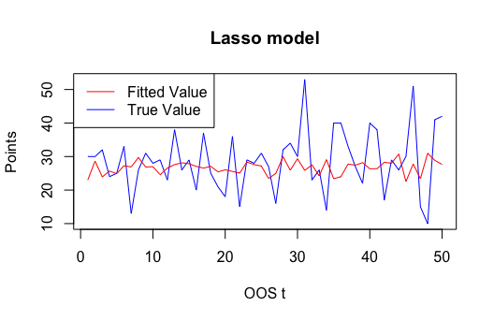
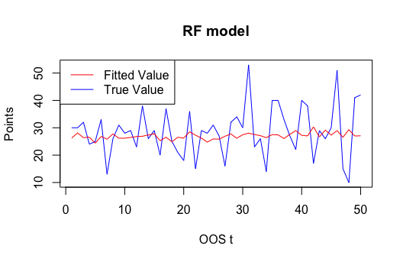
How did our models perform predicting James Harden’s Points?
James Harden - Rockets
Average RMSE 7.41
Average RMSE 7.17
Points Predicted

Slide 17
So how much is James Harden going to score tonight?
Points Predicted
31.6

